Slide 1
How to Successfully Peer Review
By: Kaylee Hernandez and Erica Lomnitz

Slide 2
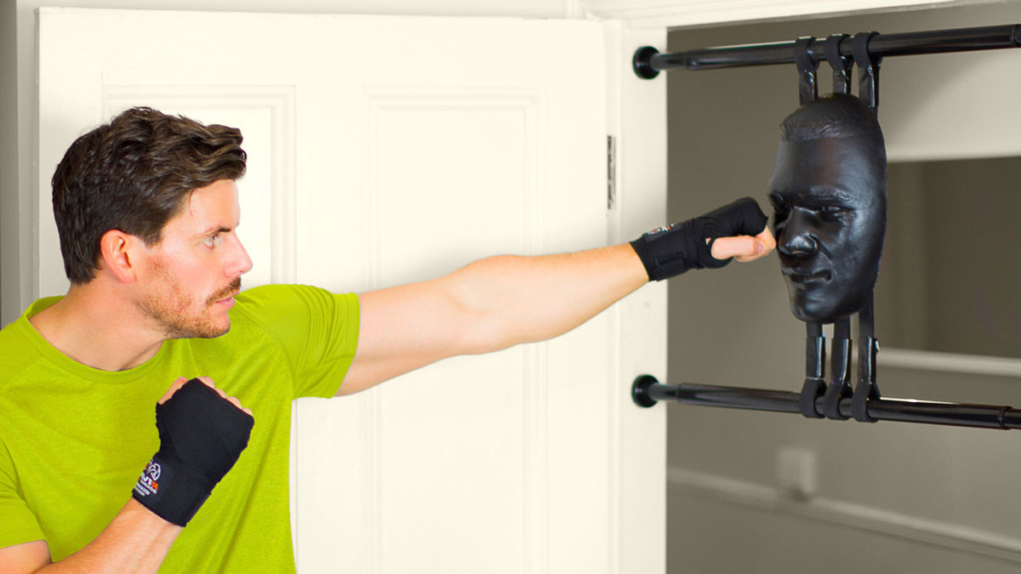
Reviewing AS-level
Get a punching bag and a stress ball or go scream outside because these kids will leave you frustrated beyond belief.

Slide 3
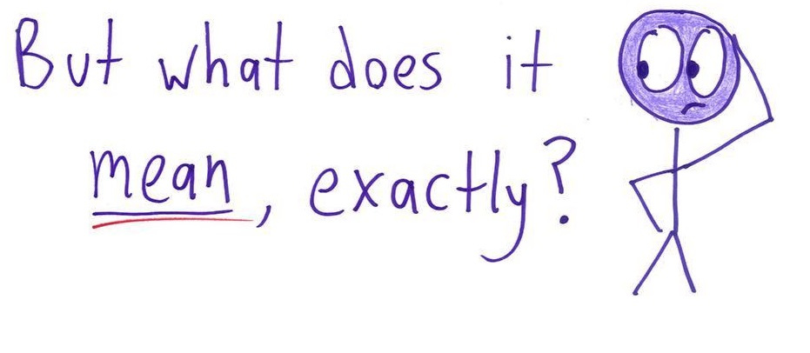
Reviewing AS-level
SIMPLIFY - remove yourself from the A-level mindset. You have to understand that analysis and evaluation are foreign to AS students.
well.. i dunno

Slide 4
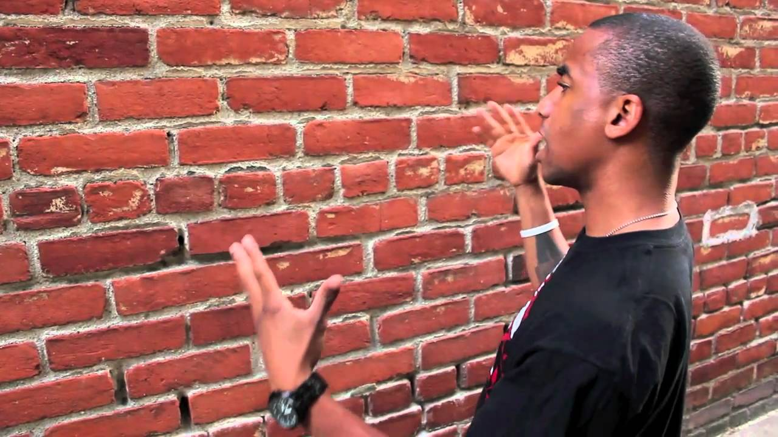
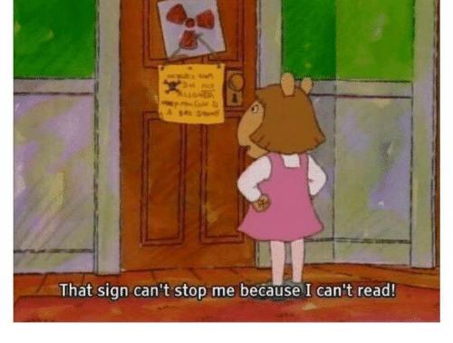
Reviewing AS-level
Accept the fact that sometimes they just won’t listen.
Always try to put in the effort and help them, but if they don’t take your advice and try as well, don’t stress about it. You can only help them as much as they are willing to allow.
my annotations
AS kids
AS kid who thinks they know everything
my effort
my time
me trying my best

Slide 5
Communicating with your AS-Students
It is really important to remain extremely clear with your annotations because you will probably never see your AS kids face-to-face.
If you feel comfortable enough doing so and have the time, leave your email/phone number/social media/etc. somewhere on their paper, so that they can contact you outside of school. This can be really useful, especially when students are absent, so if you’re willing to go that extra mile for them, do it.

Slide 6
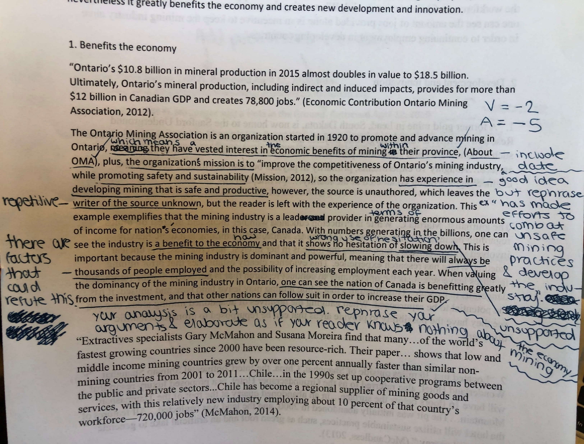
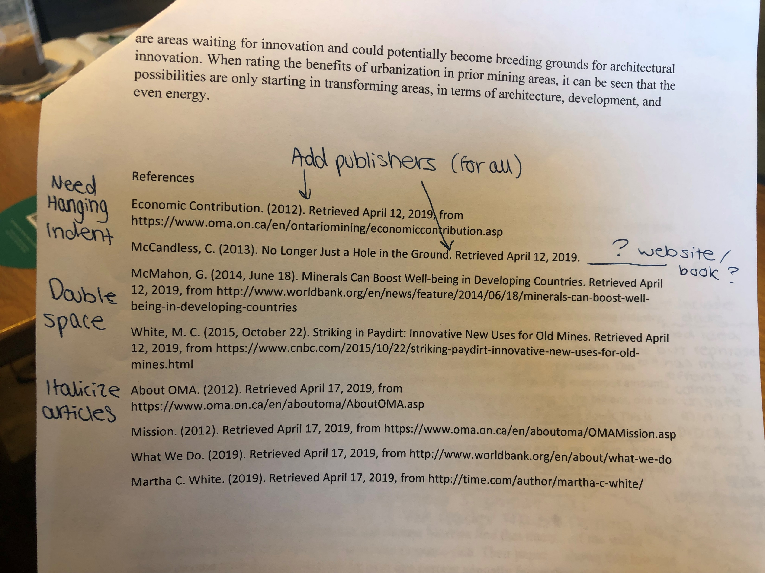
Example: Written Annotations for AS-Student

Slide 7
Example – Online Annotations for AS-Student (this is also an example of how to tell them that they’ve done something right)

Slide 8
Reviewing A-Level
USE TOUGH LOVE - These are your peers, so it’s gonna be hard to be honest, but being nice doesn’t help anyone in the long run, so sometimes you have to push past your own niceness and tell them the brutal truth.
Peer reviewing is a double sided coin, however.
So, when you see something good, tell them why/how it’s good and when you see something not so good, give them suggestions for how to improve it, don’t just tell them it’s bad.

Slide 9
Reviewing A-Level
Talk one-on-one with the person you’re peer reviewing. It is really helpful.
It allows them to understand your annotations more clearly, since they’ll be able to hear, directly from you, what your shorthand means and they’ll have the chance to ask you follow up questions on any comments that you made.

Slide 10
Reviewing A-Level
Don’t doubt your instincts and overthink whether your comment is right or wrong, just go with your gut.
If you feel something is off, just say it. At least then they can know that that section you commented on was unclear and could use improvement.
For instance, if your comment said “not analysis” when it was actually just very weak analysis, it doesn’t matter that your comment was ‘wrong’ the analysis needed improvement regardless. Make sure to provide suggestions for how they can improve their analysis (ex. use transitional phrases, etc.), or if you’re feeling extra generous, give them suggestions on how to add analysis in that section or examples of analysis statements that they could use.

Slide 11
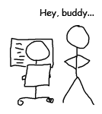
Reviewing A-level
Have one main peer review buddy that you can go to. Make sure it’s someone you’re comfortable receiving criticism from and who is able to provide you with honest commentary.
This will allow you both to become very familiar with each other’s topics. And that helps in the long run when your paper starts to become more detailed and in depth and someone reading it cold might not get where you’re coming from.
Just as important, however: make sure you have people in your class that can read your paper cold. They will give you honest first-read opinions.

Slide 12
Reviewing A-level
If you are coming in from any other global class, or are weak at citation rules, then you need to familiarize yourself with citations. They are so important for not just your own paper, but also for when you’re peer reviewing others.
Citation format should be: Author’s Name (Last, F. M.), Date published/or date accessed if there is no publication date, (Year, Month Day), Article title. Publisher. Retrieved on (date) from: URL
PRO TIP

Slide 13
Example – Online Annotations for A-Level Student

Slide 14
Example - Continued

Slide 15
Annotation System
Have a system that you use.
Like the example in the last slide, you can use shorthand and colors to annotate more effectively.
Red text are typos corrected.
Yellow highlighted text are grammar or punctuation mistakes corrected.
Blue text are rewritten words/sentences.
Here are the shorthand annotations that the Cambridge graders will use, familiarize yourself with them.
IRR – irrelevant material
DES – merely describing factual material
SOME ARG – some relevant argument
GOOD ARG – good argument
EX ARG – excellent argument (particularly effective and well supported)
NOT CLEAR – the point being made isn’t easy to follow
ASS – assertion (just stating an unsupported view)
WELL SUPP – view is well backed-up
S – source (only referenced)
S USED – a source is used uncritically to support a point/argument
SOME EVAL – some critical comment but not very strong or developed
GOOD EVAL – supported and developed evaluation
EX EVAL – excellent evaluation (particularly effective and well supported)
NOT REF – no reference or footnote
CONC FOLLOWS – conclusion follows directly from the arguments
NOT SHOWN EARLIER – new material introduced without any reference to earlier argument
IRR – conclusion deals with material outside the scope of the question

Slide 16
Tools
These tools are your friends, utilize them.

